Slide 1

Shanghai
Presentation of Law on
the Administration of
Exit-Entry Certificates
Bureau of Exit-Entry Administration Shanghai Municipal Public Security Bureau
Notes:
Presentation of law on the administration of exit-entry certificates
Bureau of Exit-Entry Administration Shanghai Municipal Public Security Bureau

Slide 2



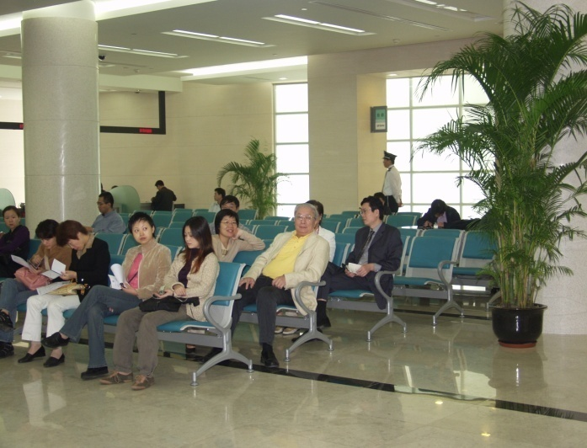
My bureau locatied, at 1500 Minsheng Road pudong province.

Slide 3

Daily Work
Process resident permit & visa application
Investigate violations of exit-entry administration law
Consulate liaison
Enforce residence registration
Process landing visa application at airports & seaports
Process passport & travel document application（Chinese）
Notes:
Daily Work

Slide 4

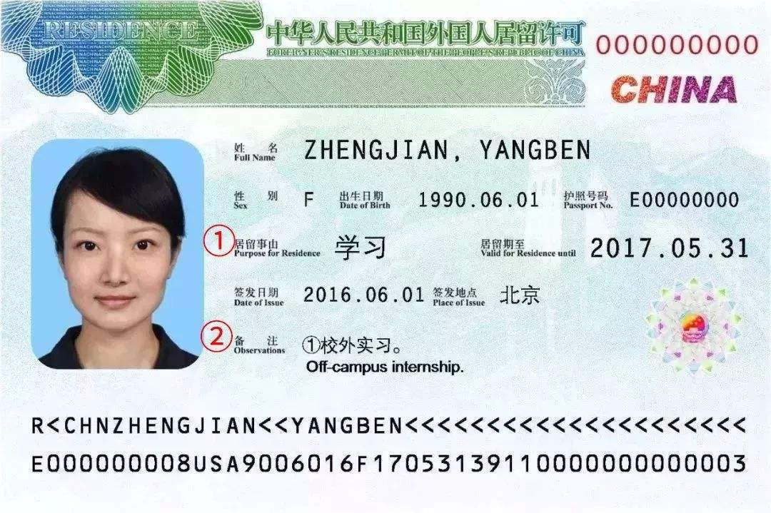

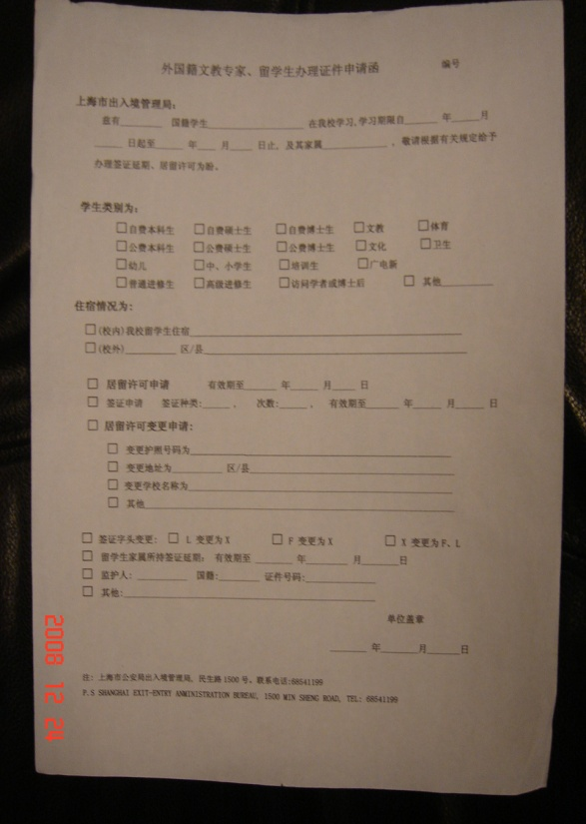
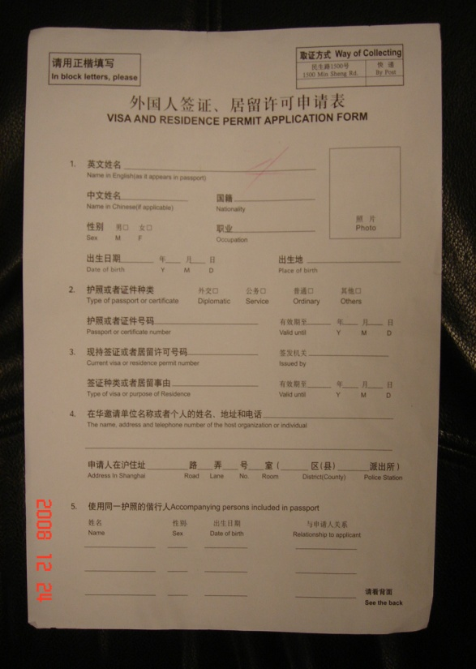
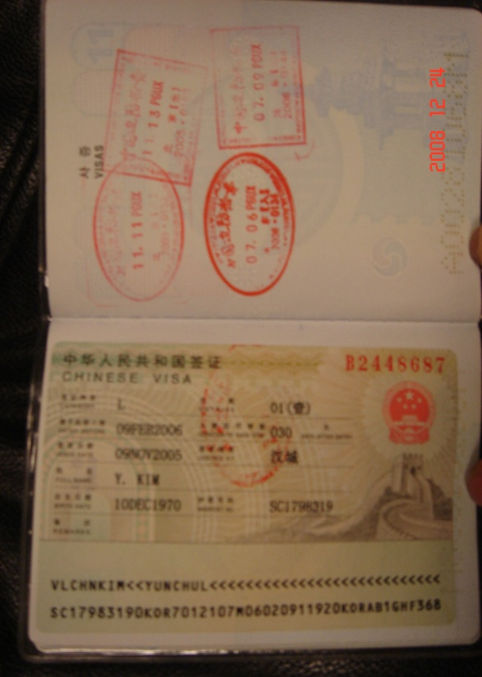
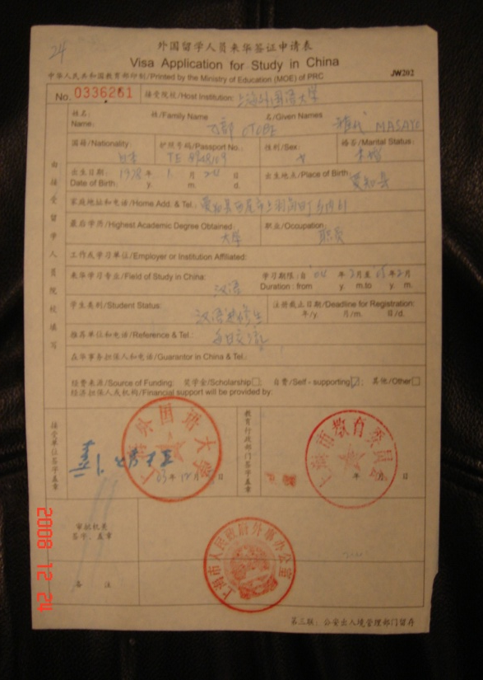
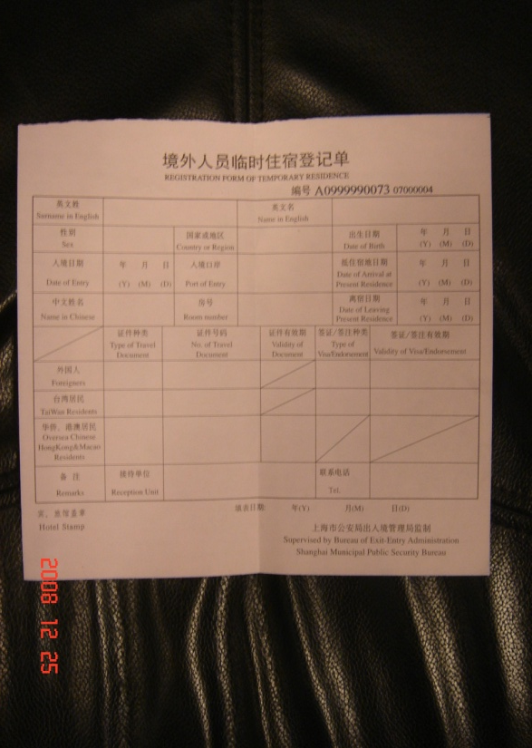
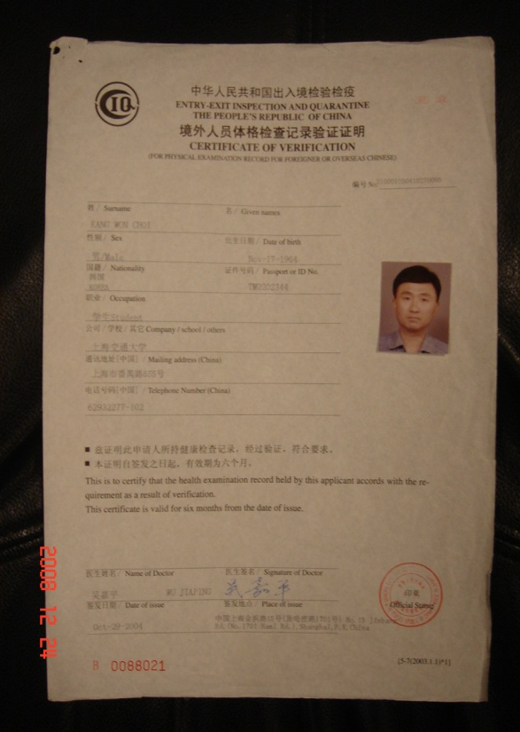
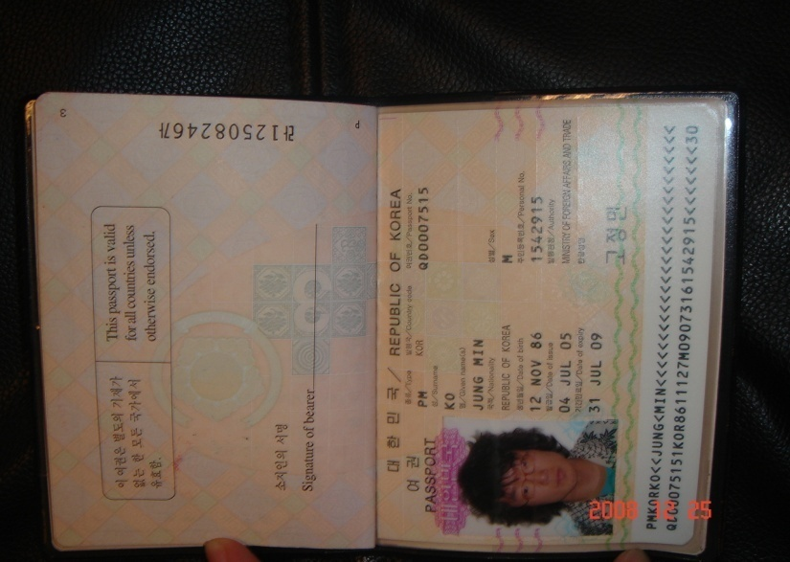
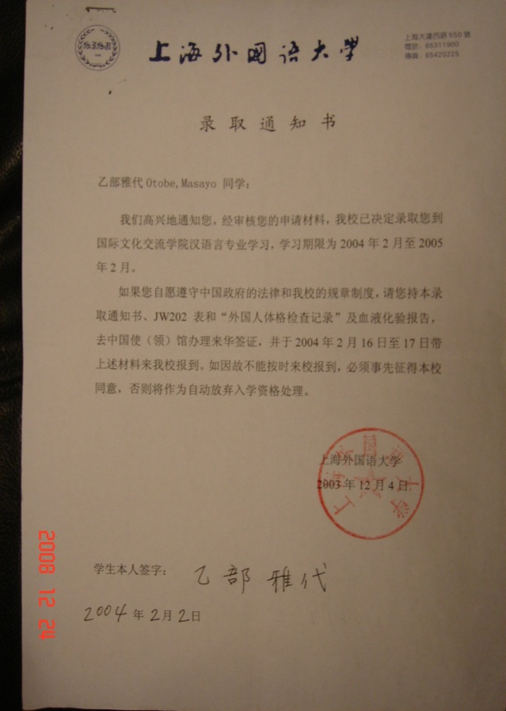
THE UNIVERSITY!
An introduction letter
from the University
YOURSELF!
Admission notice
JW202 or JW201
Health check report
Registration Form for
Temporary Residence
Congratulation！
An application form completed
Valid passport with valid visa
Documents for the residence permit

Slide 5

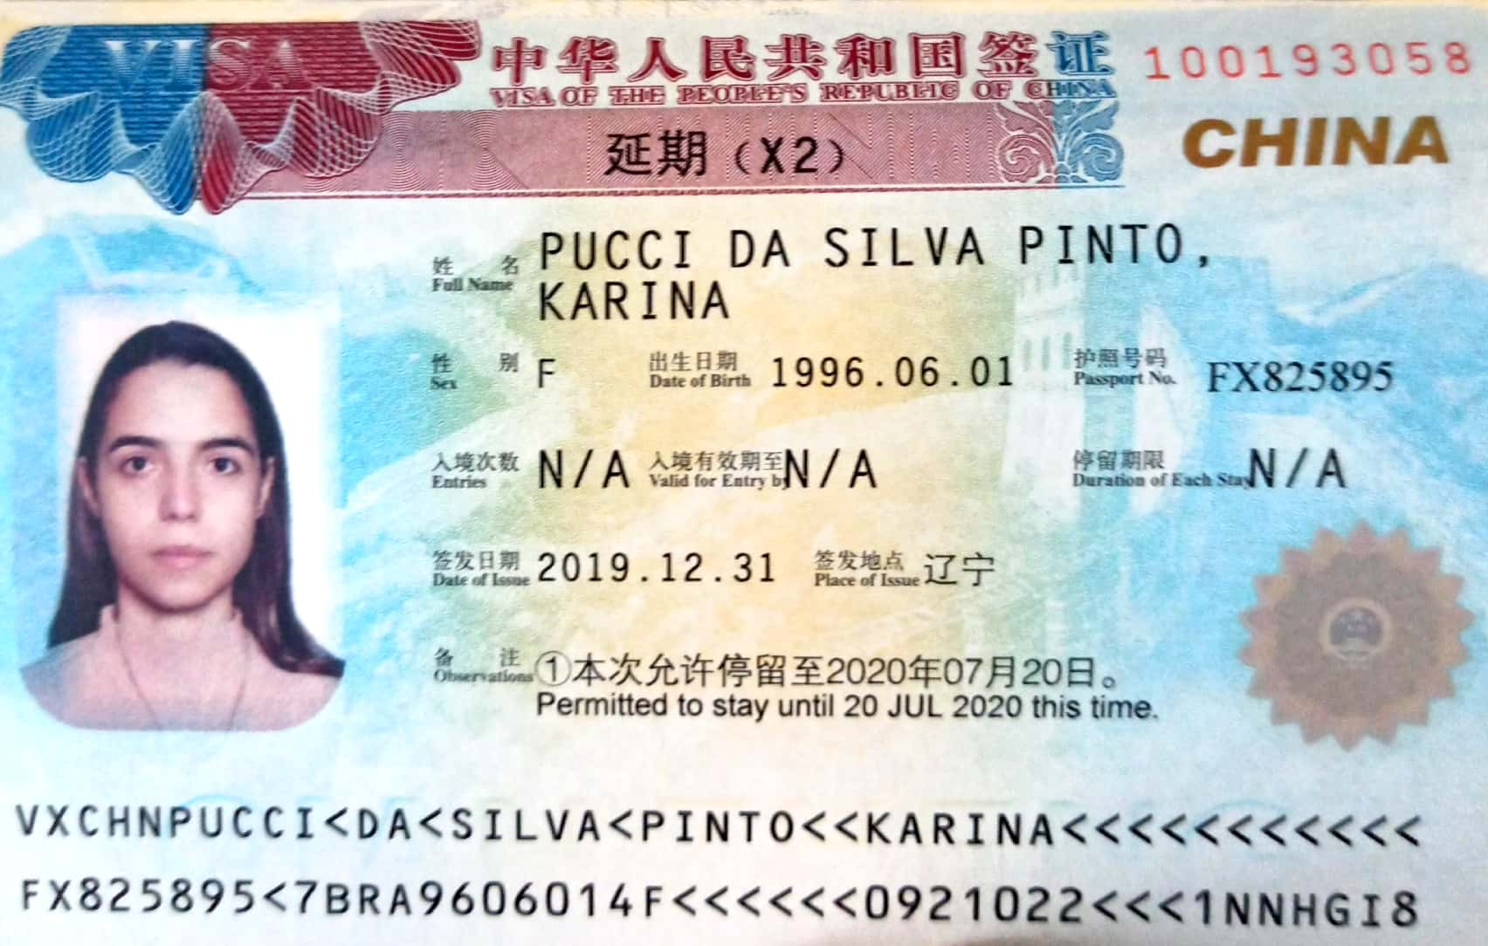
Duration of your study
Less than 6 months
More than 6 months
X2 visa
Residence permit
6 months

Slide 6


Different
Health check report
An introduction letter
from the University
Admission notice
JW202 or JW201
Registration Form for
Temporary Residence
One entry
Multiple entry
An application form completed
Valid passport and visa
Documents for application

Slide 7

1、
Something about registration of residence
1
2
3
go through the registration procedure in local police station with passport within 24 hours
go through the registration procedure in local police station with passport within 24 hours.
go through the registration procedure in check-in counter with passport in time
With registration system
Without registration system
Out of the school
Notes:
Registration of residence for international teachers
For teachers accommodated in international teachers’ building with registration system—go through the registration procedure in check-in counter with passport in time.
For teachers accommodated in international teachers’ building without registration system—go through the registration procedure in local police station with passport within 24 hours.
For teachers accommodated outside the university—go through the registration procedure in local police station with passport within 24 hours.

Slide 8
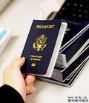






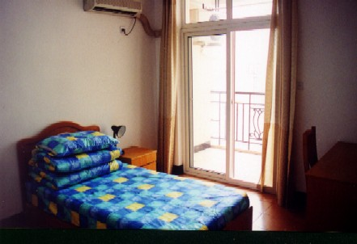


1、
Something about registration of residence
办理住宿登记时应携带住宿人有效护照以及租赁文件、房产证明或单位证明等材料。
居住社区，在城镇的，应在24小时内至当地派出所申报住宿登记。
在宾旅馆内住宿，应出示有效护照、并填写住宿登记单。
Valid passport，contract of tenancy，ownership certificate，university certificate,is necessary.
Live in the hotels,a foreigners shoule present their passports or residence permits and fill in the registration.
Lodge in the house in urban areas should fill in the registration form of temporary residence within 24 hours.

Slide 9


LOG ON
Scan the “QR” cord
Use the “APP” just as wechat
Log in the website
https://crjzndg.gaj.sh.gov.cn/24hr

Slide 10
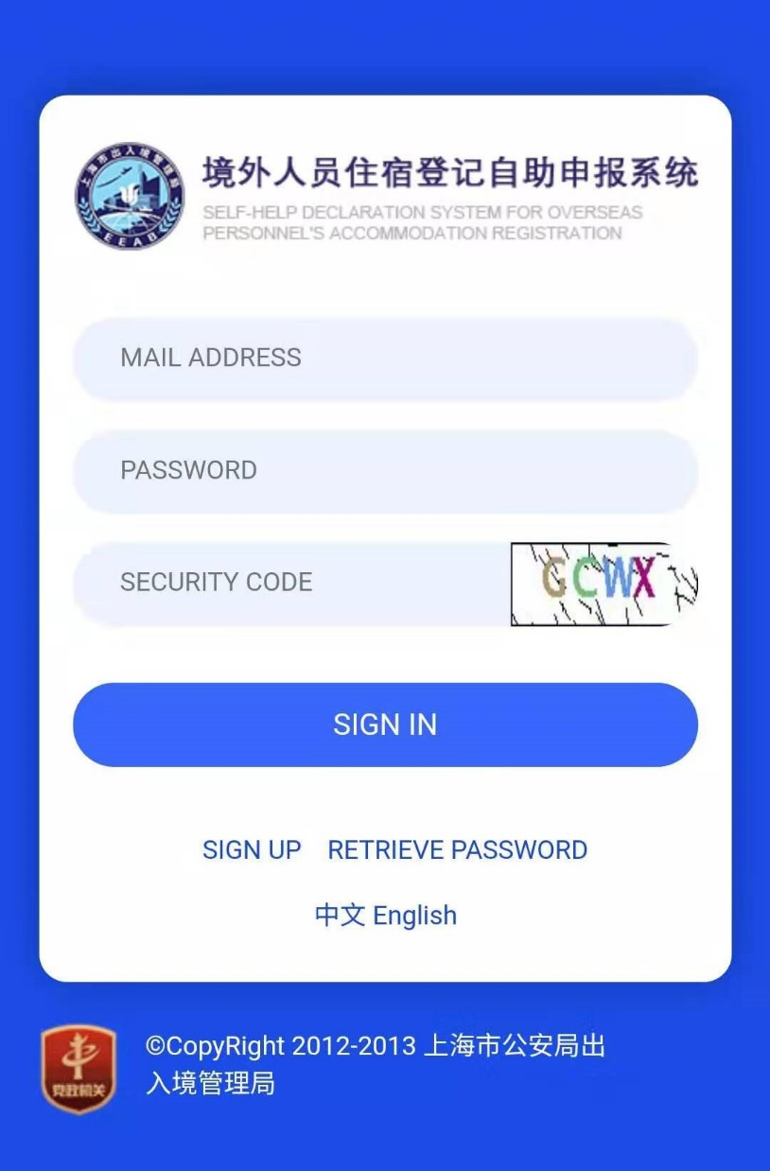
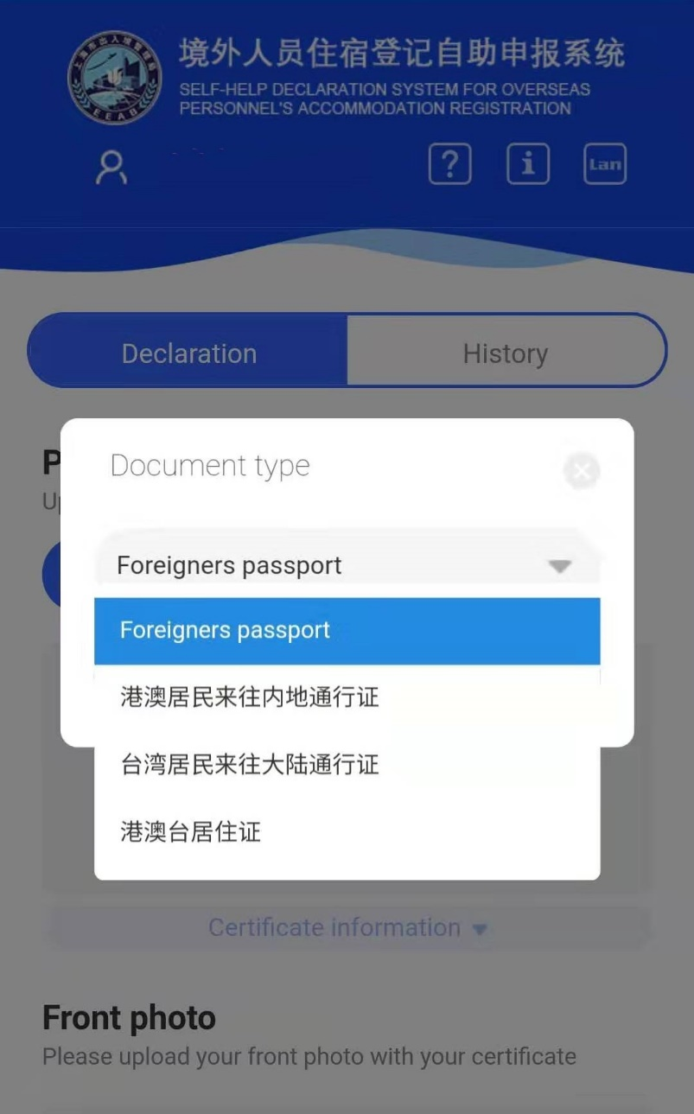
DECLARE
Select document type
SIGN IN

Slide 11
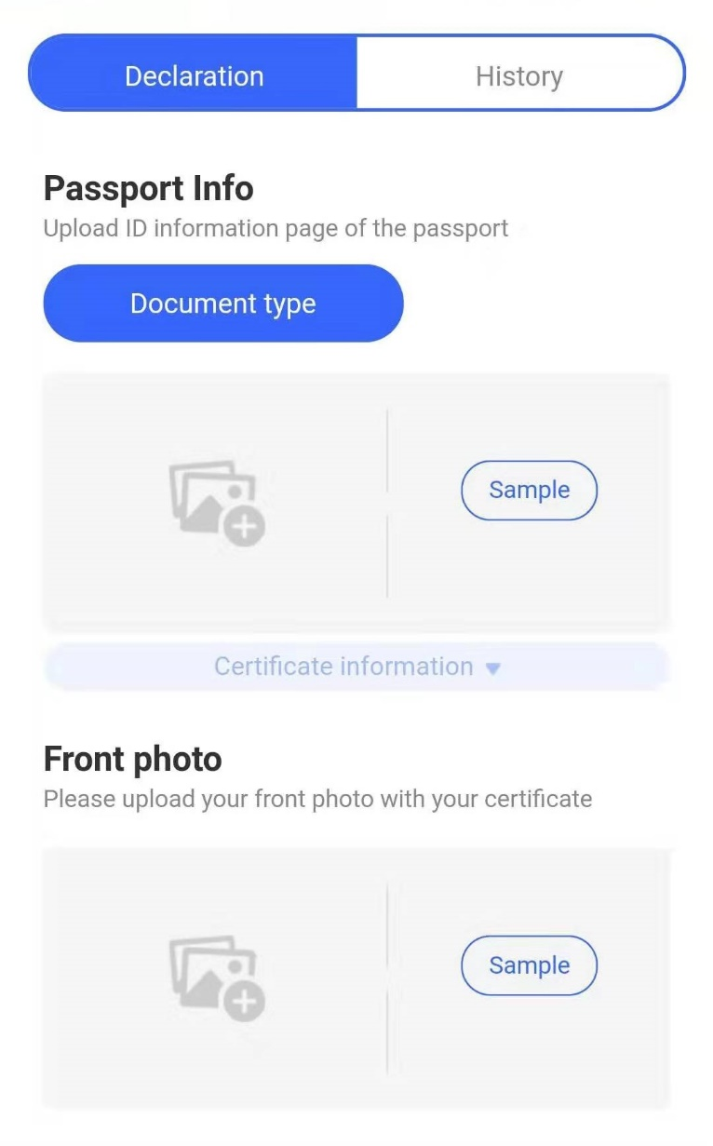
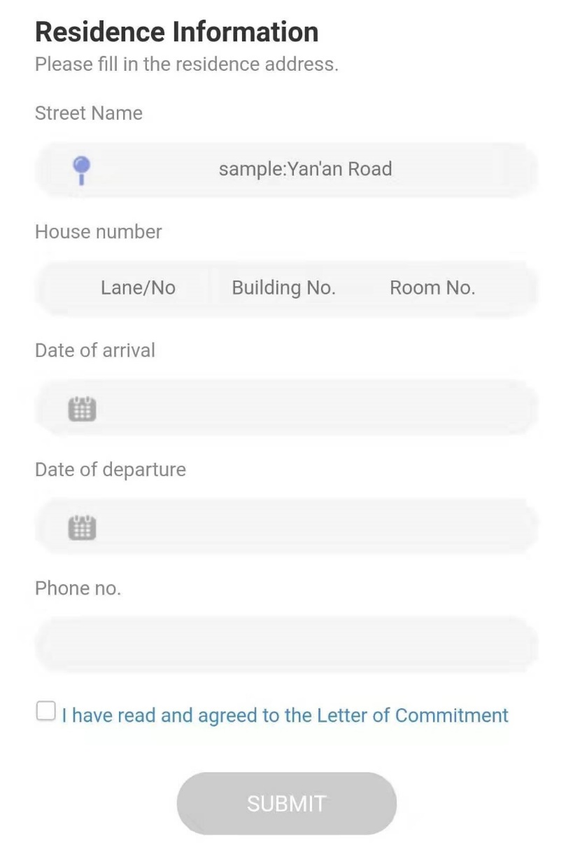
DECLARE
Write down your address
3 pieces photoes

Slide 12
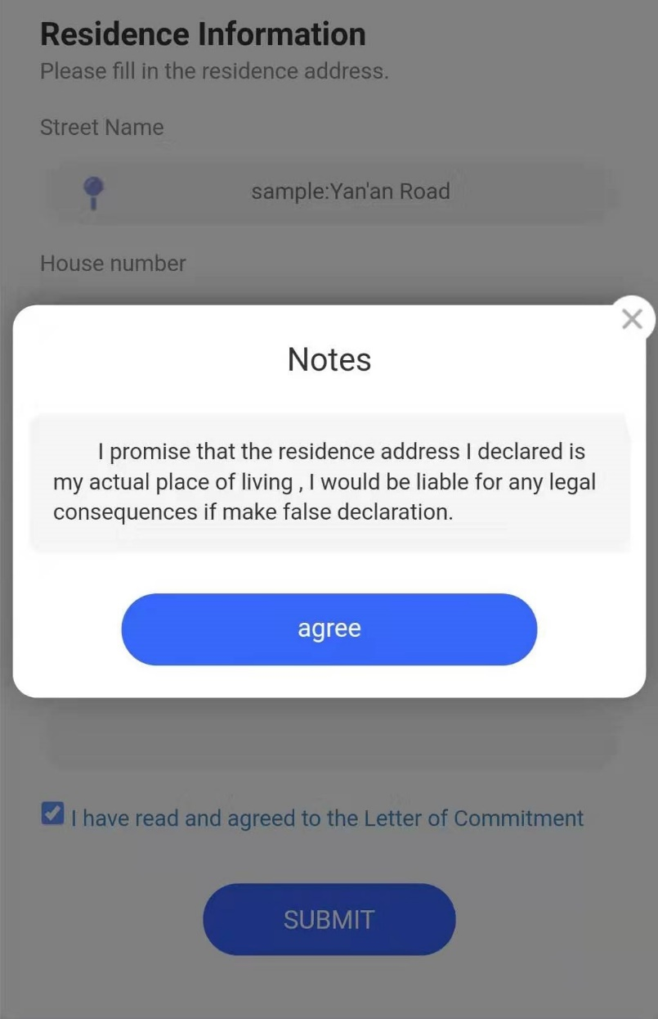
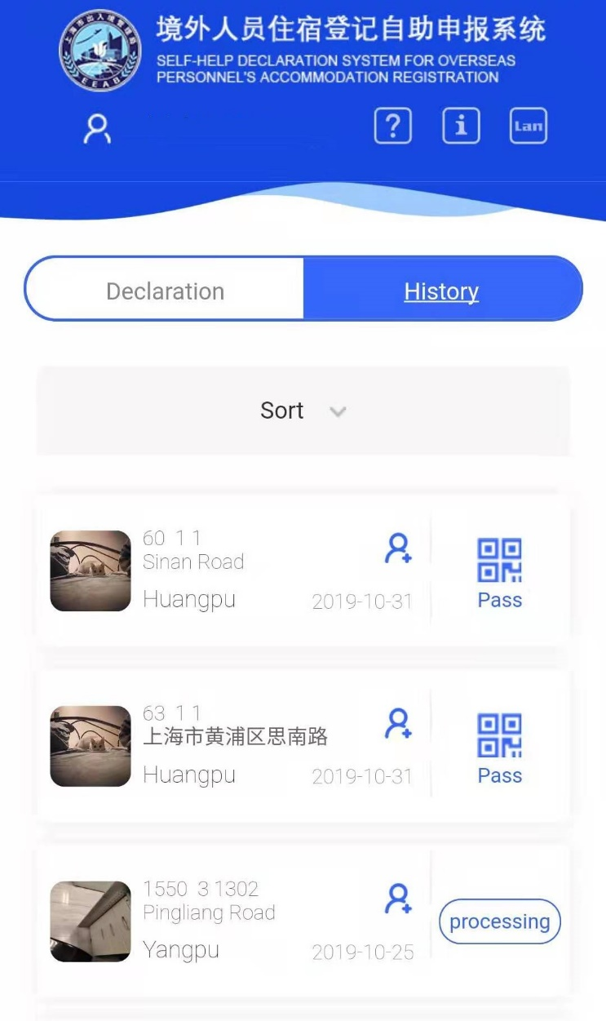
DECLARE
Agree the notes
Check the result

Slide 13
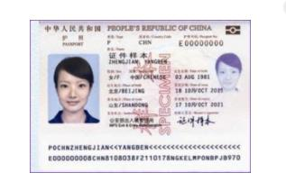
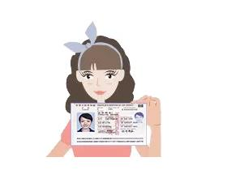
ATTENTIONS
Document of yourself
Avoid reflect light
Your document and yourself

Slide 14
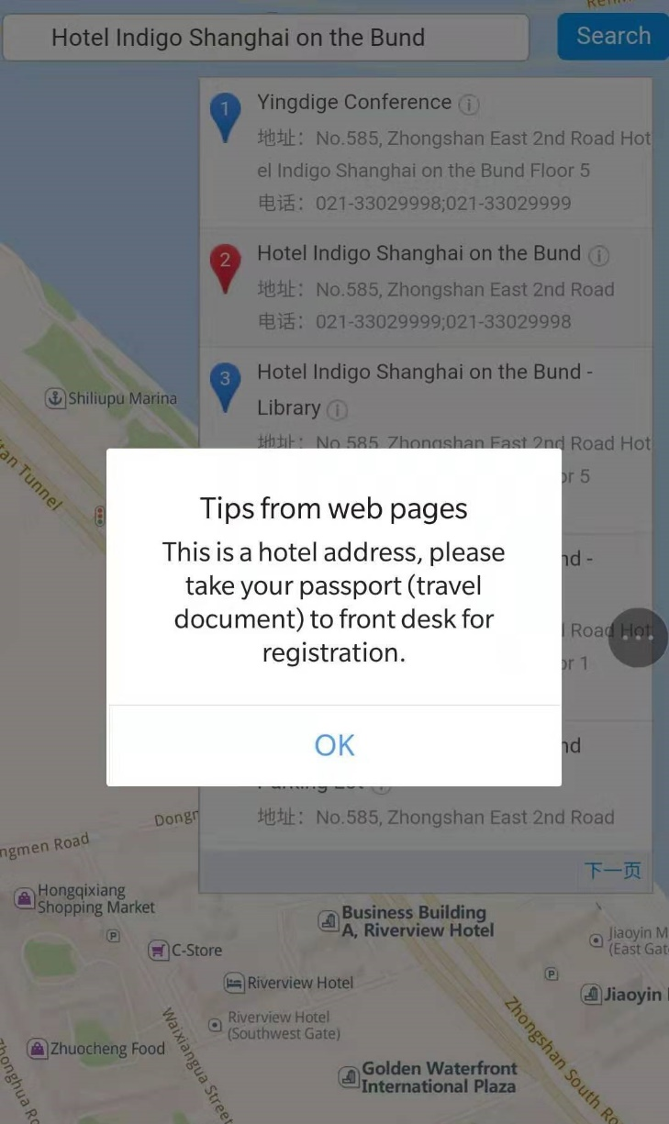
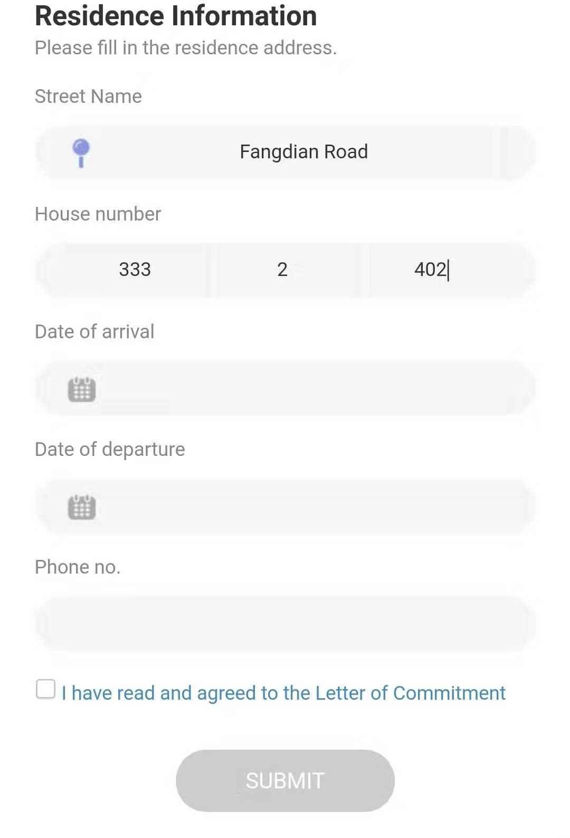
ATTENTIONS
Can use the electronic map to confirm the street name
Hotel can not use this system

Slide 15
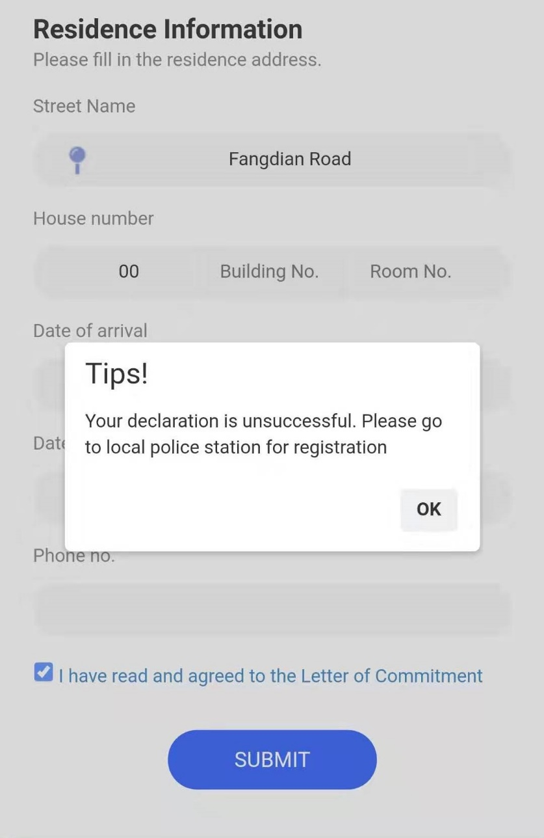

ATTENTIONS
Maybe the address is wrong
If we cannot find the entry record we will check the information of your passport plese wait with patience

Slide 16

ATTENTIONS
Take good care of your Registration Form
Ⅰ
Ⅱ
Do the registration again if you have changed your name, nationality, type and number of your certificates.
Do not have to register again if you enter China with a residence permit and stay in the same place
Ⅲ
Ⅳ
Do the registration within fixed time period each time you enter China with any visa other than residence permit.
Notes:
ATTENTION
1. Take good care of your Registration Form for Temporary Residence.
2. Do the registration again if you have changed your name, date of birth, nationality, type and number of your certificates.
3. Do not have to register again if you enter China with a residence permit and stay in the same place in China.
4. Do the registration within fixed time period each time you enter China with any visa other than residence permit.

Slide 17
2、
Something about cases
Criminal
Society order
Visa regulation
Embezzlement of property.
Fighting
Illegal stay
Conflicts and injuries caused by drinking.
Theft.
Fail to get “Registration form for temporary residence” in time
Gambling.
Fighting caused by trivial matters.
Drug abuse.
Engage in activities that do not conform to his/her identity.
Sexual offenses.
Drinking-driving.
Notes:
3. Type of cases
Criminal cases:
Embezzlement of property.
2. Conflicts and injuries caused by drinking.
3. Fighting caused by trivial matters.
4. Sexual offenses.
Social-order cases
5. Fighting.
6. Theft.
7. Gambling.
8. Drug abuse.
9. Over-driving.
Exit-entry cases
10. Illegal stay.
11. Fail to change the residence permit when his/her purpose of stay has changed.
12. Engage in activities that do not conform to his/her identity.

Slide 18









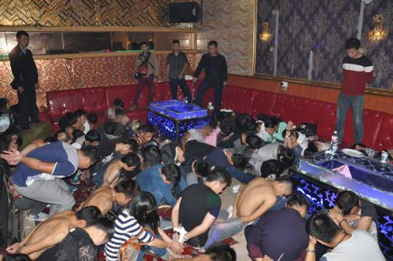

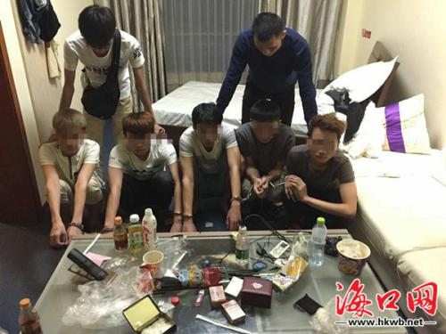







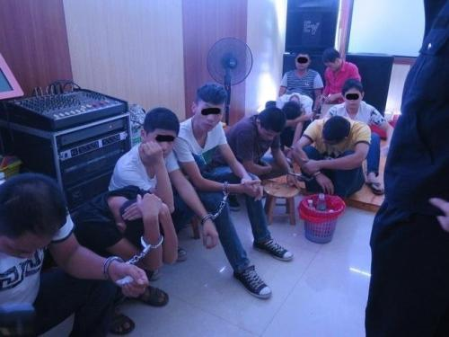

Slide 19
2、
Something about cases
Criminal
Society order
Visa regulation
Embezzlement of property.
Fighting
Illegal stay
Conflicts and injuries caused by drinking.
Theft.
Fail to get “Registration form for temporary residence” in time
Gambling.
Fighting caused by trivial matters.
Drug abuse.
Engage in activities that do not conform to his/her identity.
Sexual offenses.
Drinking-driving.
Notes:
3. Type of cases
Criminal cases:
Embezzlement of property.
2. Conflicts and injuries caused by drinking.
3. Fighting caused by trivial matters.
4. Sexual offenses.
Social-order cases
5. Fighting.
6. Theft.
7. Gambling.
8. Drug abuse.
9. Over-driving.
Exit-entry cases
10. Illegal stay.
11. Fail to change the residence permit when his/her purpose of stay has changed.
12. Engage in activities that do not conform to his/her identity.

Slide 20

2、
Something about cases
刑事案件
Society order
Visa regulation
Punishment！
Embezzlement of property.
Fighting
Illegal stay
Conflicts and injuries caused by drinking.
Theft.
Will be deported
Fail to get “Registration form for temporary residence” in time
1 day of illegal stay will be fined RMB500，more than 60 days will be interned.
Gambling.
Fighting caused by trivial matters.
Drug abuse.
Engage in activities that do not conform to his/her identity.
Will be fined RMB 2000.
Sexual offenses.
Over-driving.
(skip classes or illegal employment )
Notes:
3. Type of cases
Criminal cases:
Embezzlement of property.
2. Conflicts and injuries caused by drinking.
3. Fighting caused by trivial matters.
4. Sexual offenses.
Social-order cases
5. Fighting.
6. Theft.
7. Gambling.
8. Drug abuse.
9. Over-driving.
Exit-entry cases
10. Illegal stay.
11. Fail to change the residence permit when his/her purpose of stay has changed.
12. Engage in activities that do not conform to his/her identity.

Slide 21

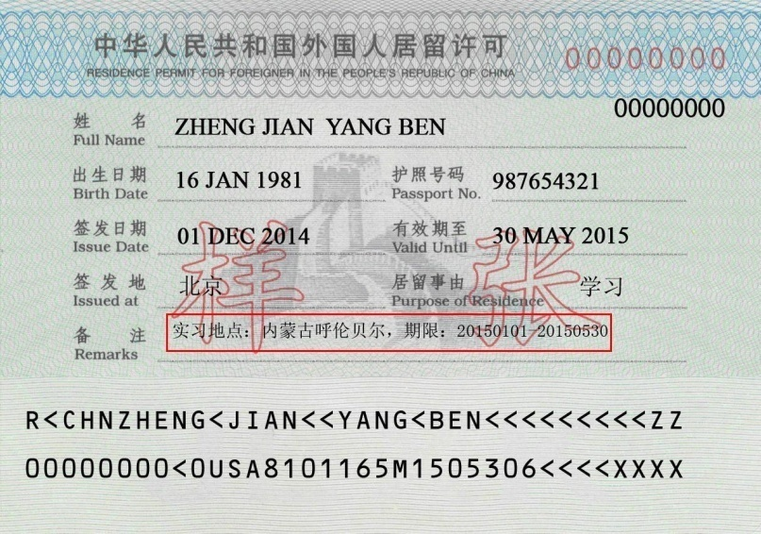
Something about internship：
Shang Hai
Should arranged by the Uniersity and have remarks on the R.P.
Can go to other city

Slide 22
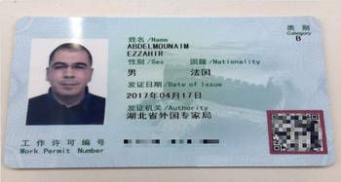

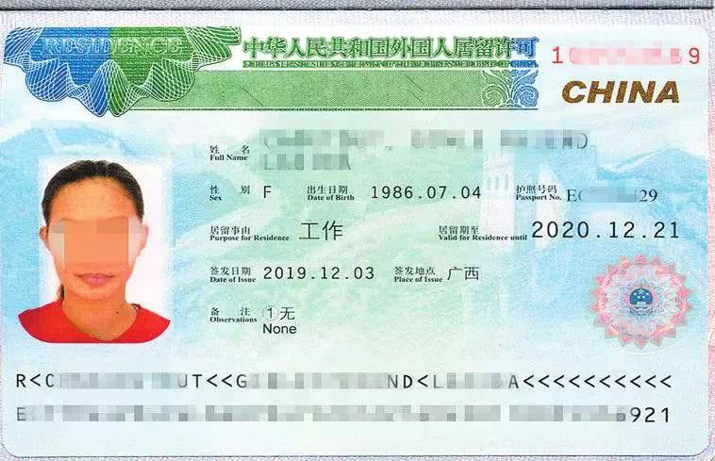

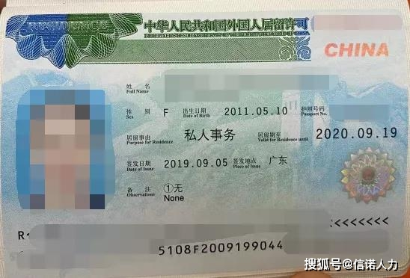

Internationer student should have two years working experiences
Innovate or start up business
Internationer student should have work permit
free-trade zone
hi-tech park

Slide 23
Bachelor degree can get jobs in company which is sign in those areas.
Mast or docor degree can get jobs in any company in Shanghai.
Shanghai
Jiading new town
Qingpu N.T
free-trade zone
hi-tech park
Songjiang N.T
Nanhui N.T
Fengxina N.T
Policy of Technology Innovation Center
Ask Foreigner Expert bureau for further information

Slide 24



Telecommunications fraud
Congratulations win award but before get zhe bonus you should pay taxes .
Tragedy at “ATM”
Password of Your credit card have been stolen so you’d better transfer money To a “safety” Account.
Results！

Slide 25
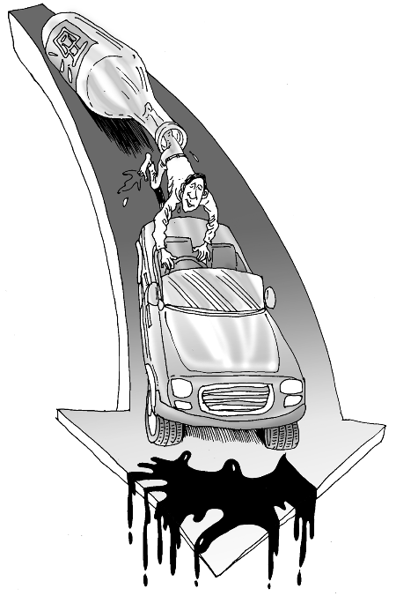

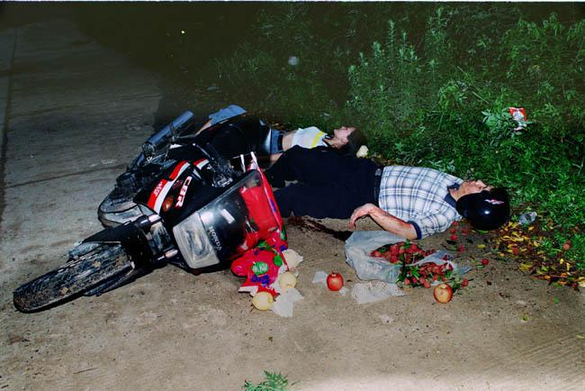


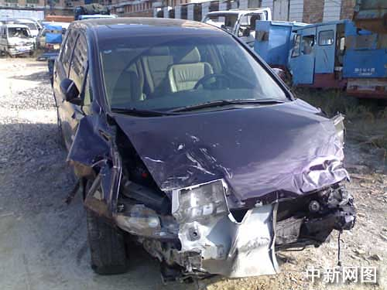

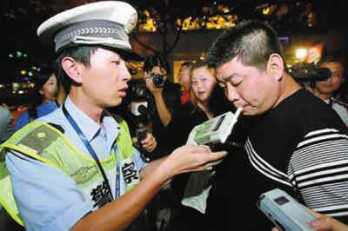


Slide 26



Our suggestions！
Safety precautions in room
Safety precautions in public places
Enhance security examination
Guard against robbery
Prevent gas poisoning accidents from happen- ing
Keep your personal belongs safe
Avoid over-taking of alcohol
Observe traffic laws and regulations
It is the sacred duty of Shanghai police to safeguard
the legal rights of overseas students in Shanghai!
Notes:
Our suggestions
Safety precautions in room
Enhance security examination
Guard against robbery
Prevent gas poisoning accidents from happening
Safety precautions in public places
Keep your personal belongs safe
Avoid over-taking of alcohol
Observe traffic laws and regulations
It is the sacred duty of Shanghai police to safeguard the legal rights of overseas students in Shanghai!

Slide 27


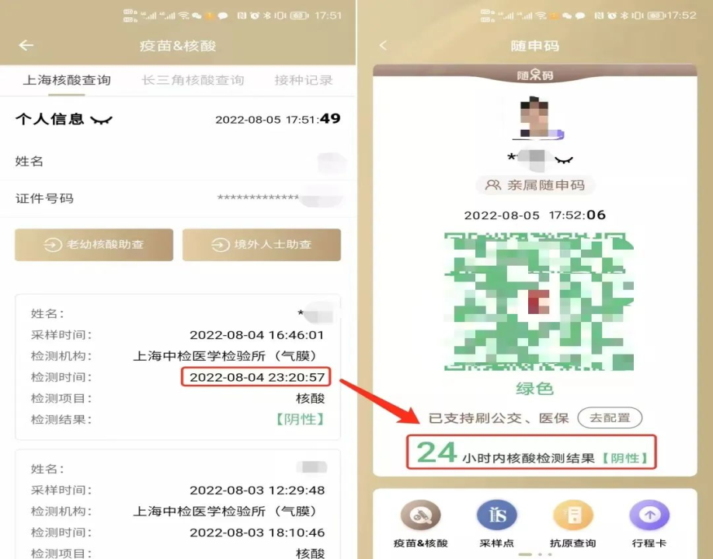
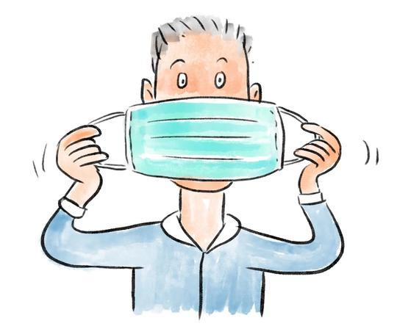
Get the NAT(nucleic acid testing) every 72 hours and check the result on your cell-phone
72

Slide 28



Shang Hai
Do not broken the Rugulations of epidemic prevention

Slide 29









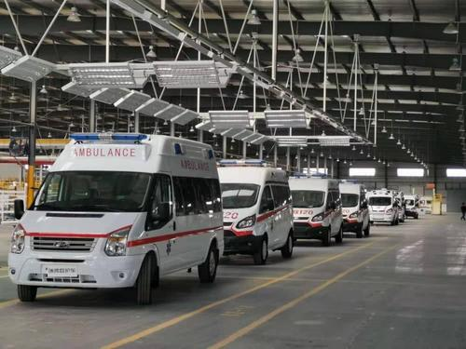

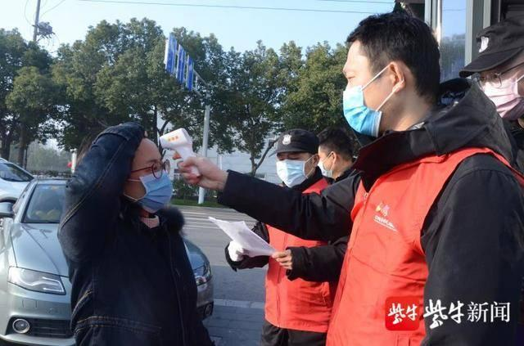





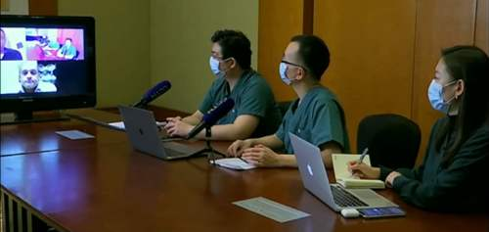
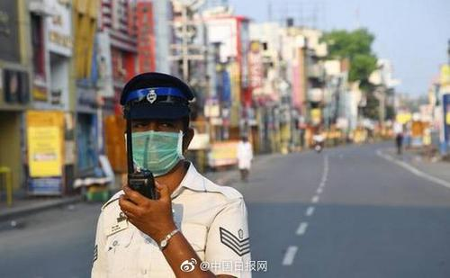
Notes:
Presentation of law on the administration of exit-entry certificates
Bureau of Exit-Entry Administration Shanghai Municipal Public Security Bureau

Slide 30
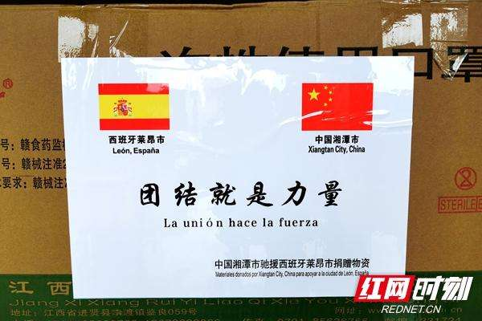

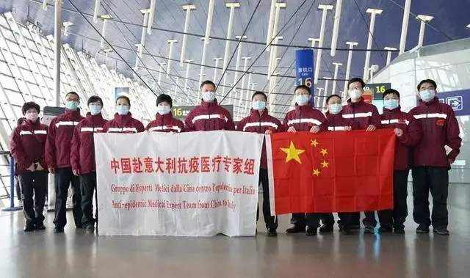


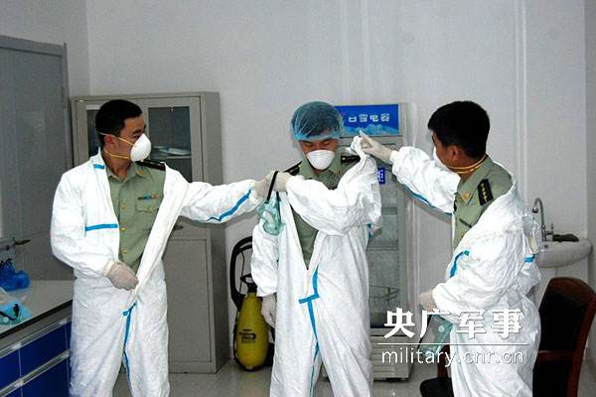



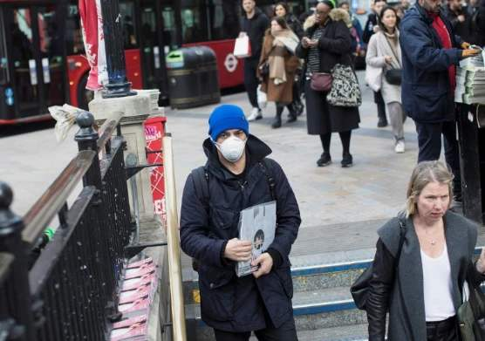


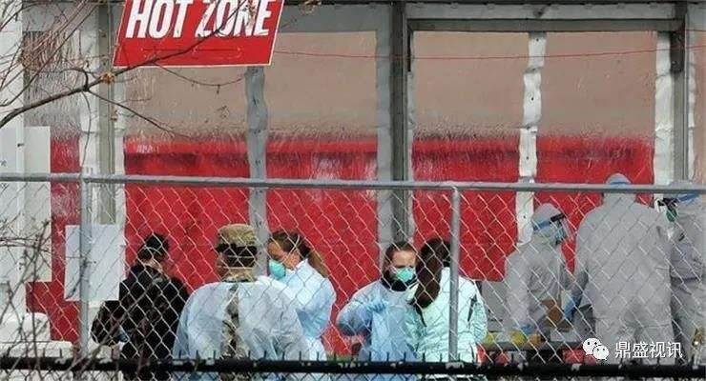


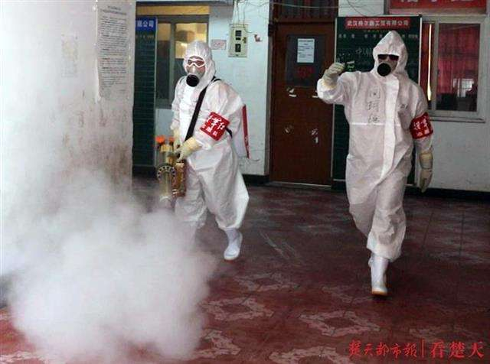




Notes:
Presentation of law on the administration of exit-entry certificates
Bureau of Exit-Entry Administration Shanghai Municipal Public Security Bureau

Slide 31

China
Goodluck
Over the world
Notes:
Presentation of law on the administration of exit-entry certificates
Bureau of Exit-Entry Administration Shanghai Municipal Public Security Bureau

Slide 32


谢谢大家
A LOT
THANKS
Bureau of Exit-Entry
Administration
Notes:
Thank you!

